Slide 1
Polymorphism and Abstract Classes

Slide 2
Introduction
Polymorphism
Enables “programming in the general”
The same invocation can produce “many forms” of results
Interfaces
Implemented by classes to assign common functionality to possibly unrelated classes

Slide 3
Polymorphism
When a program invokes a method through a superclass variable,
the correct subclass version of the method is called,
based on the type of the reference stored in the superclass variable
The same method name and signature can cause different actions to occur,
depending on the type of object on which the method is invoked

Slide 4
Polymorphism
Polymorphism enables programmers to deal in generalities and
let the execution-time environment handle the specifics.
Programmers can command objects to behave in manners appropriate to those objects,
without knowing the types of the objects
(as long as the objects belong to the same inheritance hierarchy).

Slide 5
Polymorphism Promotes Extensibility
Software that invokes polymorphic behavior
independent of the object types to which messages are sent.
New object types that can respond to existing method calls can be
incorporated into a system without requiring modification of the base system.
Only client code that instantiates new objects must be modified to accommodate new types.
Notes:
Late Binding:
We often treat an object not as its own type, but as its base type (superclass or interface). This allows you to write codes that do not depends on a specific implementation type. In the Shape example, we can always use getArea() and do not have to worry whether they are triangles or circles.
This, however, poses a new problem. The compiler cannot know at compile time precisely which piece of codes is going to be executed at run-time (e.g., getArea() has different implementation for Rectangle and Triangle).
In the procedural language like C, the compiler generates a call to a specific function name, and the linkage editor resolves this call to the absolute address of the code to be executed at run-time. This mechanism is called static binding (or early binding).
To support polymorphism, object-oriented language uses a different mechanism called dynamic binding (or late-binding or run-time binding). When a method is invoked, the code to be executed is only determined at run-time. During the compilation, the compiler checks whether the method exists and performs type check on the arguments and return type, but does not know which piece of codes to execute at run-time. When a message is sent to an object to invoke a method, the object figures out which piece of codes to execute at run-time.
Although dynamic binding resolves the problem in supporting polymorphism, it poses another new problem. The compiler is unable to check whether the type casting operator is safe. It can only be checked during runtime (which throws a ClassCastException if the type check fails).
JDK 1.5 introduces a new feature called generics to tackle this issue. We shall discuss this problem and generics in details in the later chapter

Slide 6
Demonstrating Polymorphic Behavior
A superclass reference can be aimed at a subclass object
a subclass object “is-a” superclass object
the type of the actual referenced object, not the type of the reference, determines which method is called

Slide 7
Polymorphism
Promotes extensibility
New objects types can respond to existing method calls
Can be incorporated into a system without modifying base system
Only client code that instantiates the new objects must be modified
To accommodate new types

Slide 8
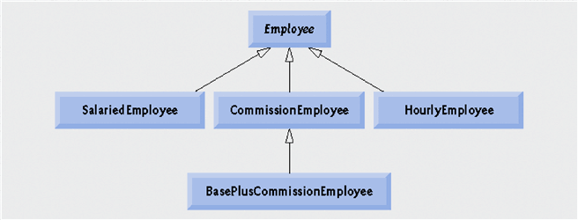
Example Based on Employee
Abstract Class
Concrete Classes

Slide 9
Example
Employee [] employees = new Employee [4];
employees[0] = new CommisionEmployee();
employees[1] = new SalariedEmployee();
employees[2] = new HourlyEmployee();
employees[3] = new BaseCommEmployee();
for ( int i=0; i<=3;i++)
{
System.out.printf(employees[i].earnngs()); employees[i].display()); }
}

Slide 10
Note in Example Hierarchy
Dynamic binding
Also known as late binding
Calls to overridden methods are resolved at execution time, based on the type of object referenced

Slide 11
Downcasting
for ( int i=0; i<4;i++) {
If (employees [i] instanceof BasePlusCommisionEmployee)
{
BasePlusCommissionEmployee emp=
(BasePlusCommissionEmployee ) employees[i];
emp.setBaseSalary( 1.10 * emp.getBaseSalary() );
S.O.P("new base salary with 10%% increase is emp.getBaseSalary() );
employee[i]=emp;
}
System.out.printf(employees[i].earnngs());
} //end for

Slide 12
Allowed Assignment between super and Sub class
Assigning a super class reference to a super class variable is straightforward.
Assigning a subclass reference to a subclass variable is straightforward.
Assigning a subclass reference to a super class variable is safe, because the subclass object is an object of its super class.

Slide 13
Allowed Assignment between super and Sub class
However, the super class variable can be used to refer only to super class members.
If this code refers to subclass-only members through the super class variable, the compiler reports errors
Downcasting can overcome this error

Slide 14
Superclass And Subclass Assignment Rules
Assigning a superclass reference to superclass variable straightforward
Subclass reference to subclass variable straightforward
Subclass reference to superclass variable safe
because of is-a relationship
Referring to subclass-only members through superclass variables a compilation error
Superclass reference to a subclass variable a compilation error
Downcasting can get around this error

Slide 15
Pitfall: No Late Binding for Static Methods
When the decision of which definition of a method to use is made at compile time, that is called static binding
This decision is made based on the type of the variable naming the object
Java uses static, not late, binding with private, final, and static methods
In the case of private and final methods, late binding would serve no purpose
However, in the case of a static method invoked using a calling object, it does make a difference

Slide 16
The final Modifier
A method marked final indicates that it cannot be overridden with a new definition in a derived class
If final, the compiler can use early binding with the method
public final void someMethod() { . . . }
A class marked final indicates that it cannot be used as a base class from which to derive any other classes

Slide 17
Pitfall: Downcasting
It is the responsibility of the programmer to use downcasting only in situations where it makes sense
The compiler does not check to see if downcasting is a reasonable thing to do
Using downcasting in a situation that does not make sense usually results in a run-time error

Slide 18
Abstract Classes and Methods
Abstract classes
Are superclasses (called abstract superclasses)
Cannot be instantiated
Incomplete
subclasses fill in "missing pieces"
Concrete classes
Can be instantiated
Implement every method they declare
Provide specifics

Slide 19
Abstract Classes and Methods
Purpose of an abstract class
Declare common attributes …
Declare common behaviors of classes in a class hierarchy
Contains one or more abstract methods
Subclasses must override
Instance variables, concrete methods of abstract class
subject to normal rules of inheritance

Slide 20
Abstract Classes
Classes that are too general to create real objects
Used only as abstract superclasses for concrete subclasses and to declare reference variables
Many inheritance hierarchies have abstract superclasses occupying the top few levels

Slide 21
Keyword abstract
Use to declare a class abstract
Also use to declare a method abstract
Abstract classes normally contain one or more abstract methods
All concrete subclasses must override all inherited abstract methods

Slide 22
Creating Abstract Superclass Employee
abstract superclass Employee,
earnings is declared abstract
No implementation can be given for earnings in the Employee abstract class
An array of Employee variables will store references to subclass objects
earnings method calls from these variables will call the appropriate version of the earnings method

Slide 23
Introduction to Abstract Classes
In order to postpone the definition of a method, Java allows an abstract method to be declared
An abstract method has a heading, but no method body
The body of the method is defined in the derived classes
The class that contains an abstract method is called an abstract class

Slide 24
Abstract Method
An abstract method is like a placeholder for a method that will be fully defined in a descendent class
It has a complete method heading, to which has been added the modifier abstract
It cannot be private
It has no method body, and ends with a semicolon in place of its body
public abstract double earning();
public abstract void doIt(int count);

Slide 25
Abstract Class
A class that has at least one abstract method is called an abstract class
An abstract class must have the modifier abstract included in its class heading:
public abstract class Employee
{
private instanceVariables;
. . .
public abstract double earning();
. . .
}

Slide 26
Example Based on Employee
Abstract Class
Concrete Classes

Slide 27
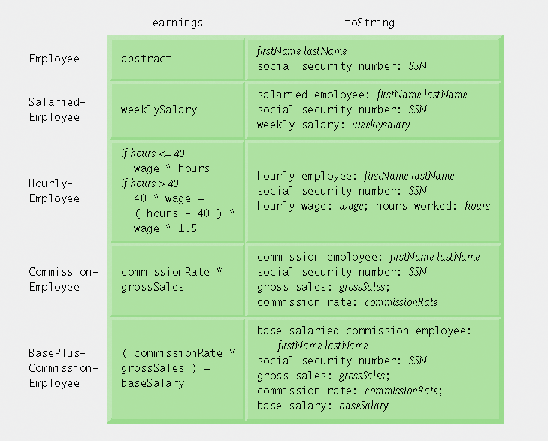
Polymorphic interface for the Employee hierarchy classes.

Slide 28
Abstract Class
An abstract class can have any number of abstract and/or fully defined methods
If a derived class of an abstract class adds to or does not define all of the abstract methods, then it is abstract also, and must add abstract to its modifier
A class that has no abstract methods is called a concrete class

Slide 29
Pitfall: You Cannot Create Instances of an Abstract Class
An abstract class can only be used to derive more specialized classes
While it may be useful to discuss employees in general, in reality an employee must be a salaried worker or an hourly worker
An abstract class constructor cannot be used to create an object of the abstract class
However, a derived class constructor will include an invocation of the abstract class constructor in the form of super

Slide 30
Tip: An Abstract Class Is a Type
Although an object of an abstract class cannot be created, it is perfectly fine to have a parameter of an abstract class type
This makes it possible to plug in an object of any of its descendent classes
Employee e = new CommissionEmployee();
It is also fine to use a variable of an abstract class type, as long is it names objects of its concrete descendent classes only

